Slide 1

University Coffee system Management
Summer Training I Project
Created By:
Ali Saheli & Ali Mazloum
Supervised By:
Dr. Mohammad Choker
Presented To:

Slide 2

Brewing Innovation:A Next-Gen Coffee Shop System
Revolutionizing the customer and operational experience for modern coffee businesses.

Slide 3



Our Vision
Elevating Coffee Shop Operations
This project aims to develop a comprehensive, intuitive, and efficient point-of-sale (POS) and management system tailored specifically for coffee shops. Our objective is to streamline daily operations, enhance customer experience, and provide actionable insights for business growth.
Seamless Transactions
Enhanced Management
Superior Customer Service
Enable faster, more accurate order taking and payment processing.
Provide tools for efficient employee scheduling, inventory control, and sales tracking.
Offer personalized ordering, loyalty programs, and rapid service.

Slide 4
Project Roadmap
What We'll Cover
Our journey to building a cutting-edge coffee shop system involves several critical phases. This presentation will delve into each, providing a detailed overview of our approach and key findings.
01
02
Literature Review
System Analysis
Understanding the current landscape of coffee shop POS systems.
Defining user needs, workflows, and system interactions.
03
04
Database Implementation
Software Implementation
Designing a robust and scalable data foundation.
Bringing the system to life through coding and user interface design.

Slide 5




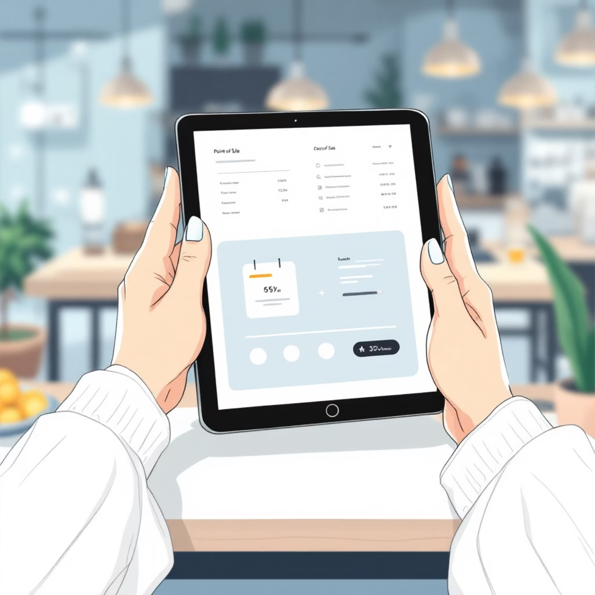
Phase 1
Literature Review: Learning from What Exists
We've conducted a thorough review of existing coffee shop POS systems and general restaurant management software. This allows us to identify best practices, common challenges, and opportunities for innovation.
Square for Restaurants
Toast POS
Popular for ease of use, basic inventory management.
Comprehensive, but often too complex/expensive for small coffee shops.
Revel Systems
Clover POS
Highly customizable, but steep learning curve.
Flexible hardware but can be limited in advanced features.
Key Takeaways :
Need for simplicity and speed in high-volume environments.
Importance of offline capability and cloud synchronization.
Demand for integrated employee management and inventory tracking.
Growing interest in customer loyalty and online ordering features.

Slide 6
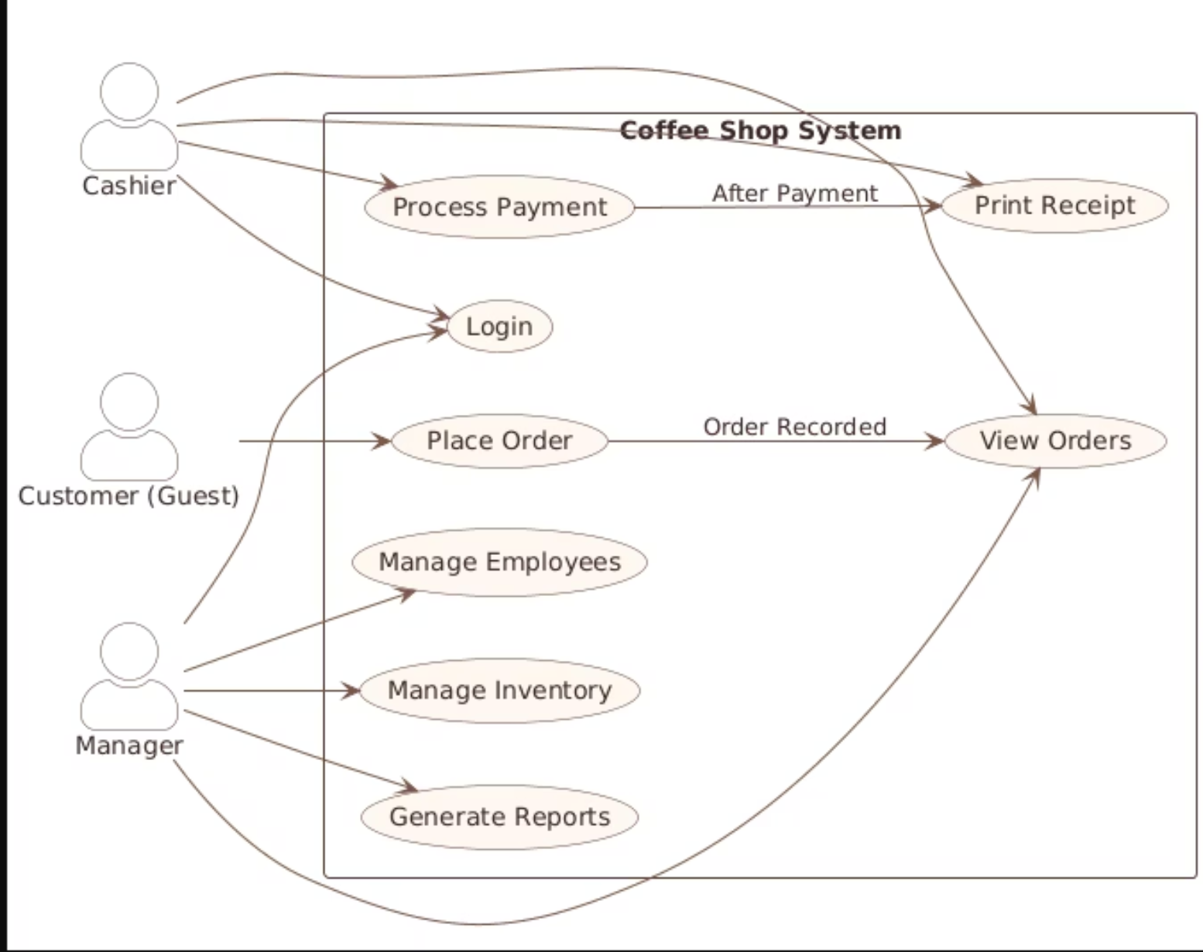
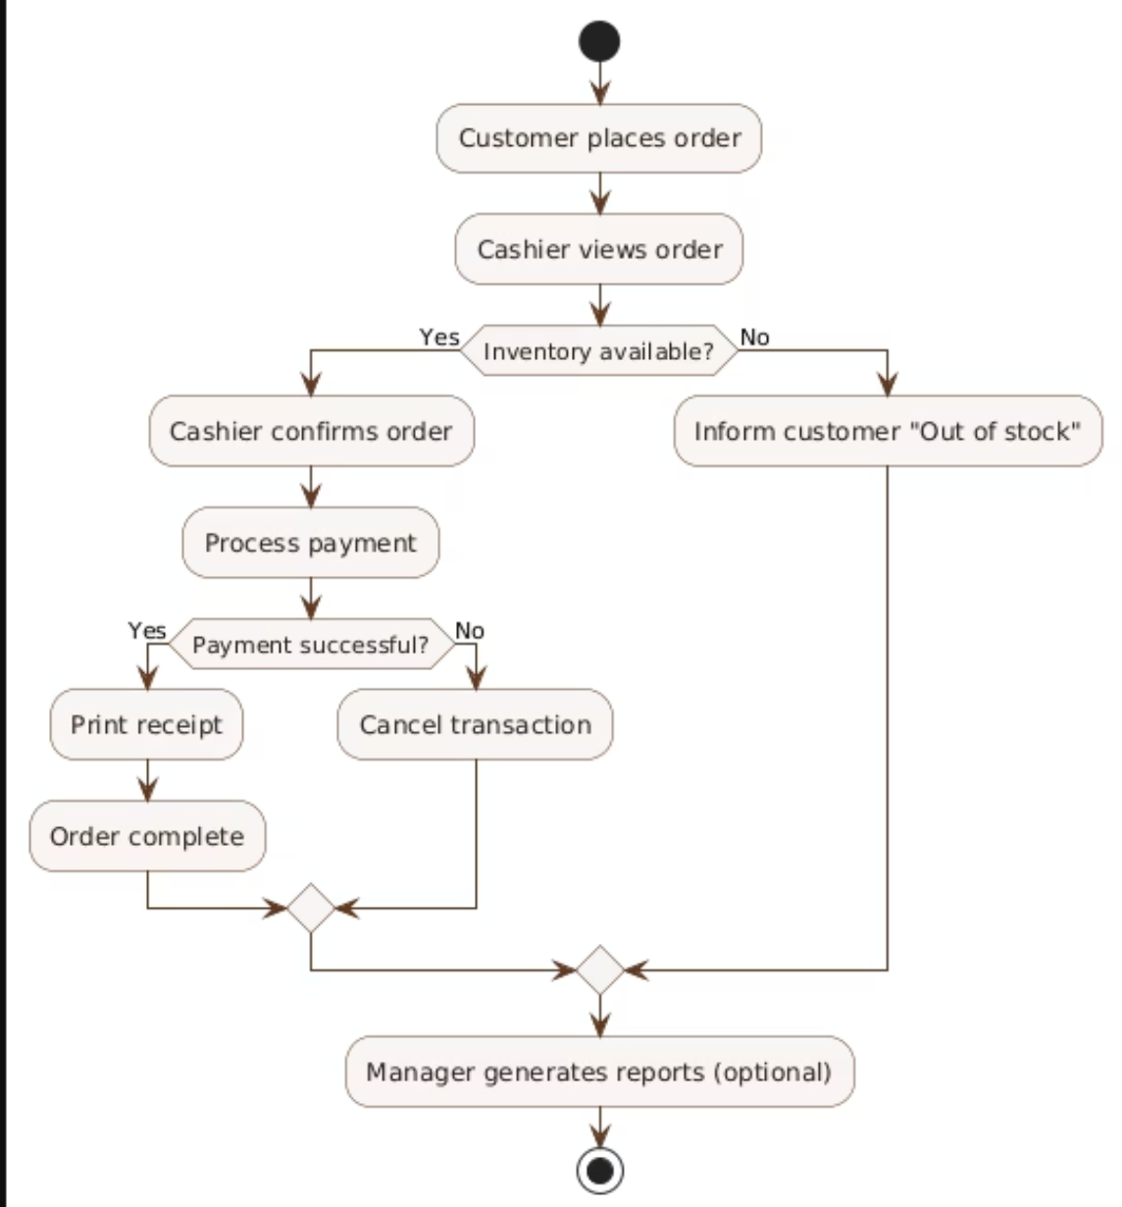
Phase 2
System Analysis: Understanding Interactions
Our system analysis phase involves a deep dive into user roles, their needs, and the sequence of actions within the coffee shop environment. This ensures our design meets practical requirements.
Use Case Diagram
Activity Diagram: Order Processing
Illustrates the different users (actors) and the specific functions (use cases) they will perform within the system.
Details the flow of activities involved in a typical coffee order, from placement to delivery, highlighting parallel processes and decision points.

Slide 7
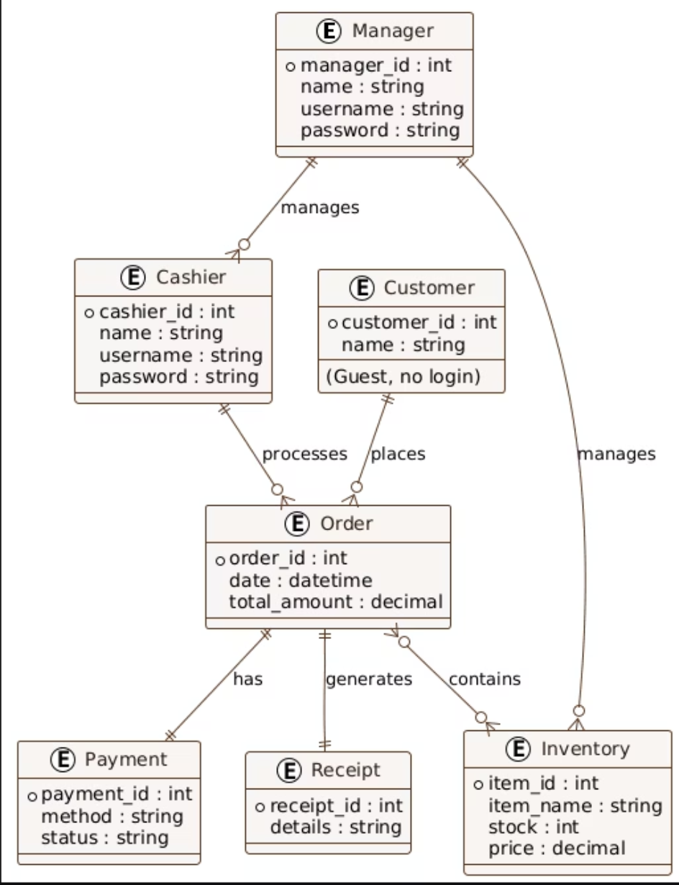
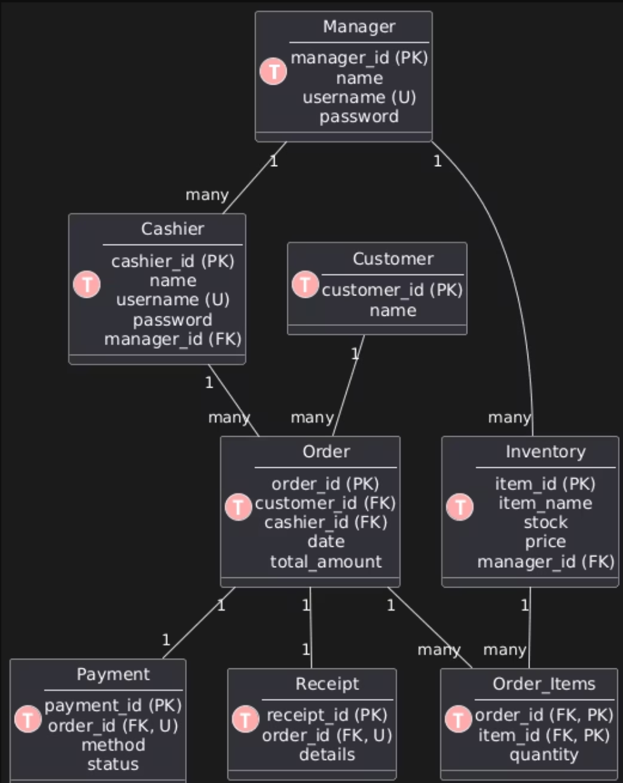
Phase 2 Continued
System Analysis: Data Structure Foundation
Beyond user interactions, a robust system relies on a well-defined data structure. We've mapped out the relationships between key entities and translated them into a relational model.
Entity-Relationship Diagram (ERD)
Relational Model
Depicts the core entities in our system (e.g., Products, Orders, Customers) and how they relate to each other, forming the backbone of our database design.
Translates the ERD into a set of tables with defined attributes and relationships, ready for database implementation.

Slide 8



Phase 3
Database Implementation: The Data Backbone
A strong coffee shop system needs a reliable database. Our design focuses on structured data organization, ensuring data integrity, and preparing for future growth.
Data Organization & Management
Data Integrity & Consistency
Scalability & Performance
Implemented constraints (primary/foreign keys, unique) to maintain accuracy and prevent errors.
Designed for high transaction volumes and future expansion, leveraging optimized indexing and caching strategies.
Structured tables for efficient storage and retrieval of product, order, customer, and employee data.
We're building a robust foundation that can handle the busiest rush hours and grow with the business.

Slide 9
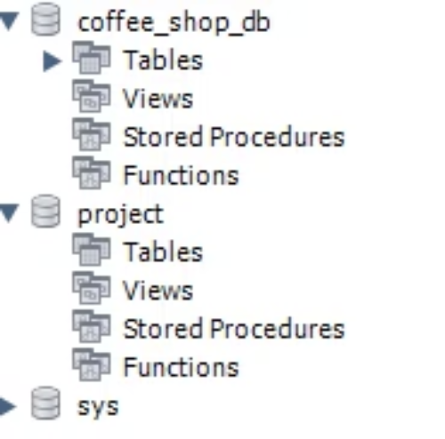
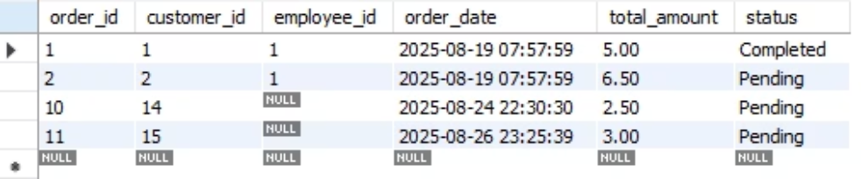
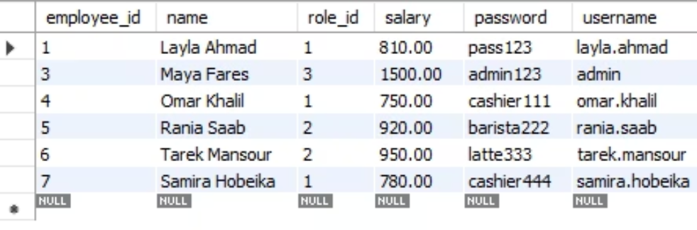
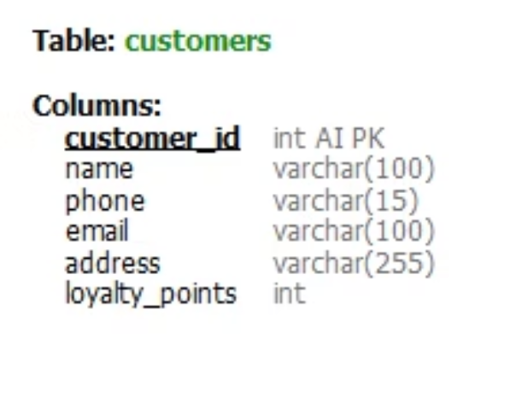
Phase 3 Continued
Database Schemas in Detail
Here's a visual representation of our database structure, illustrating how different components are organized and how individual tables are designed.
Overall Database Schema
Orders Table Schema
A detailed view of the Orders table, including data types, constraints, and relationships to customer and employee data for comprehensive transaction tracking.
Employees Table Schema
This diagram provides a high-level overview of the relational database schema, showcasing the primary tables and their interconnections.
Database Triggers
This table captures essential employee information, detailing their roles and contact data within the system.
Illustrates the logic and execution flow of database triggers, ensuring data integrity and automating specific operations based on events.

Slide 10
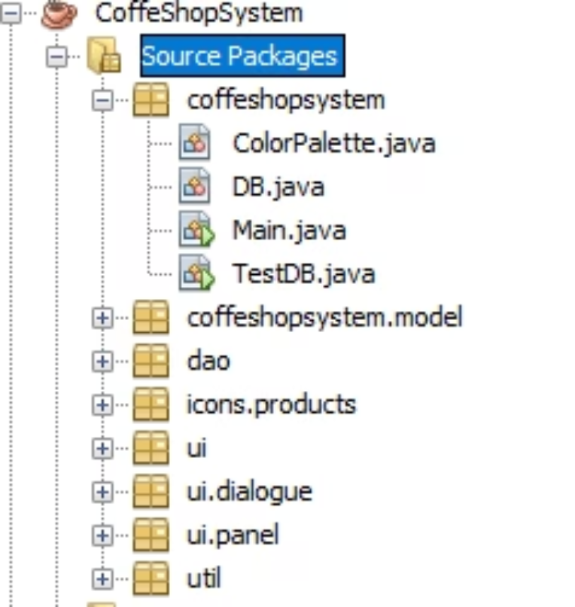
Phase 4
Software Implementation: Bringing it to Life
With the database established, our focus shifts to developing the front-end and back-end logic, creating a seamless and responsive user experience.
Java Project
employee classes
Method Name
Modifier
Purpose
addEmployee()
public
Adds a new employee record to the system.
updateEmployee()
public
Updates existing employee details (name, role, etc.).
removeEmployee()
public
Deletes an employee record from the system.
order classes
Method Name
Modifier
Purpose
create Order()
public
Creates a new customer order in the system.
Designed for speed and ease of use, minimizing clicks and training time for baristas and cashiers.
process Payment()
public
Processes the payment for an order (cash, card, etc.).
print Receipt()
public
Prints or generates a receipt for the completed order.
Empowering managers with tools for scheduling, performance tracking, and communication
all in one place.

Slide 11
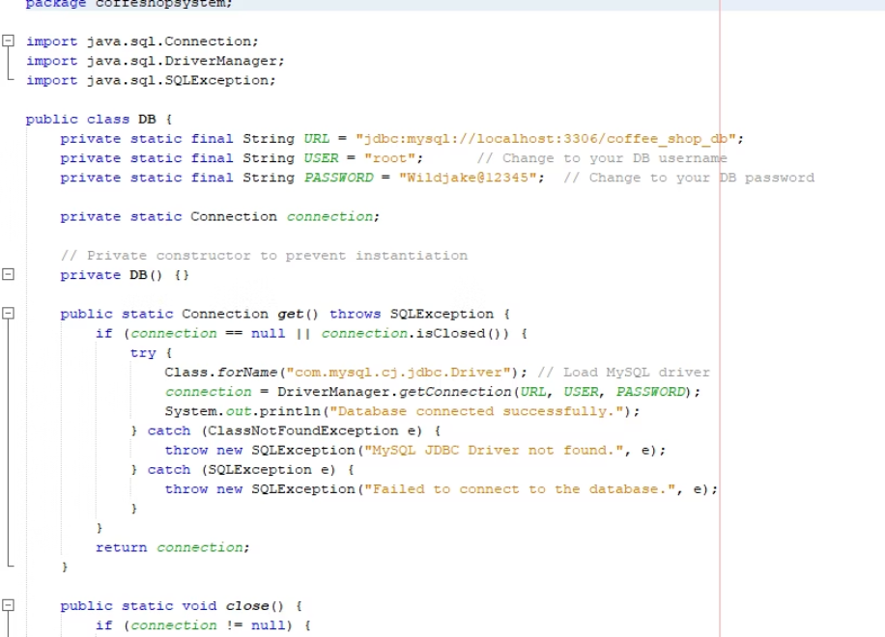
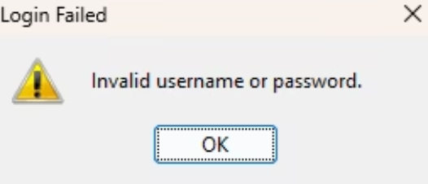
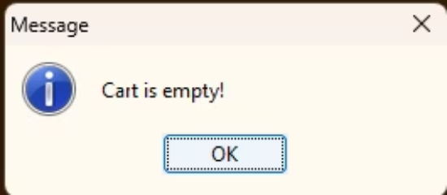
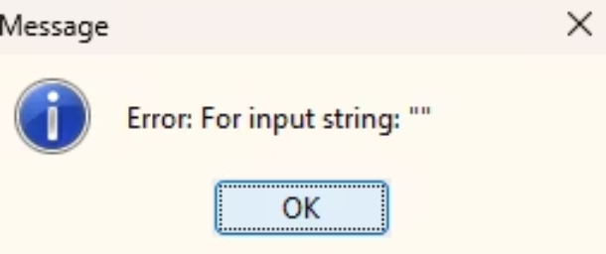
Phase 4 Continued
Software Implementation: Robustness & Reliability
Beyond core functionality, we're building a system that is resilient and handles unforeseen issues gracefully, ensuring data integrity and a smooth user experience through robust backend processes.
Database Connectivity (JDBC)
Exception Handling & Input Validation
Seamlessly connecting our Java application to the database, JDBC ensures efficient data interaction, enabling real-time updates and consistent information flow.
Robust exception handling prevents crashes and ensures graceful recovery from errors, while comprehensive input validation safeguards data integrity and enhances security.

Slide 12
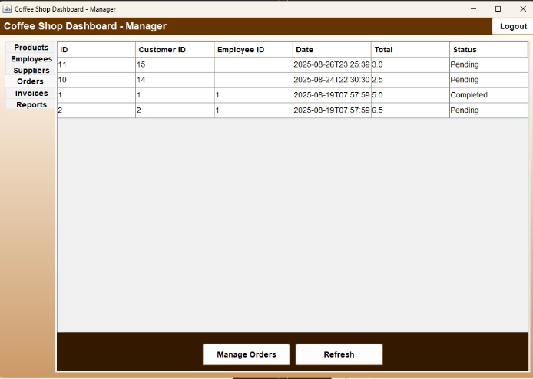
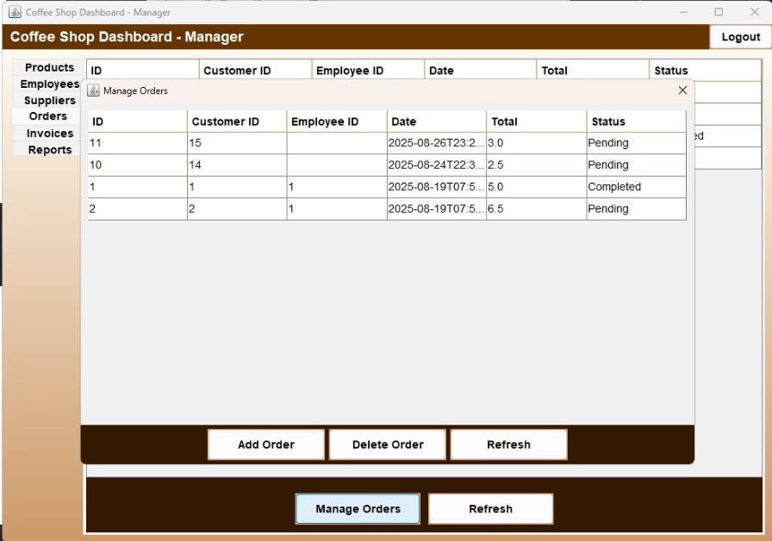
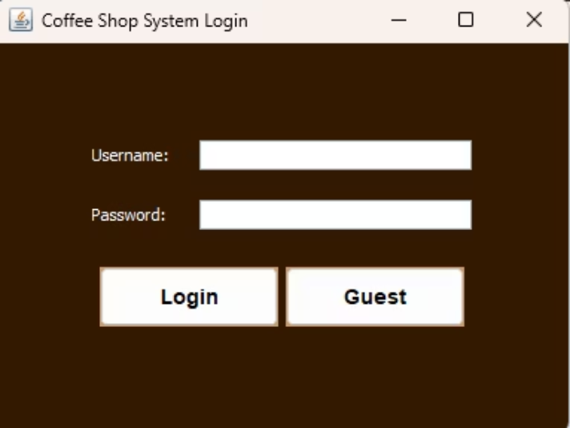
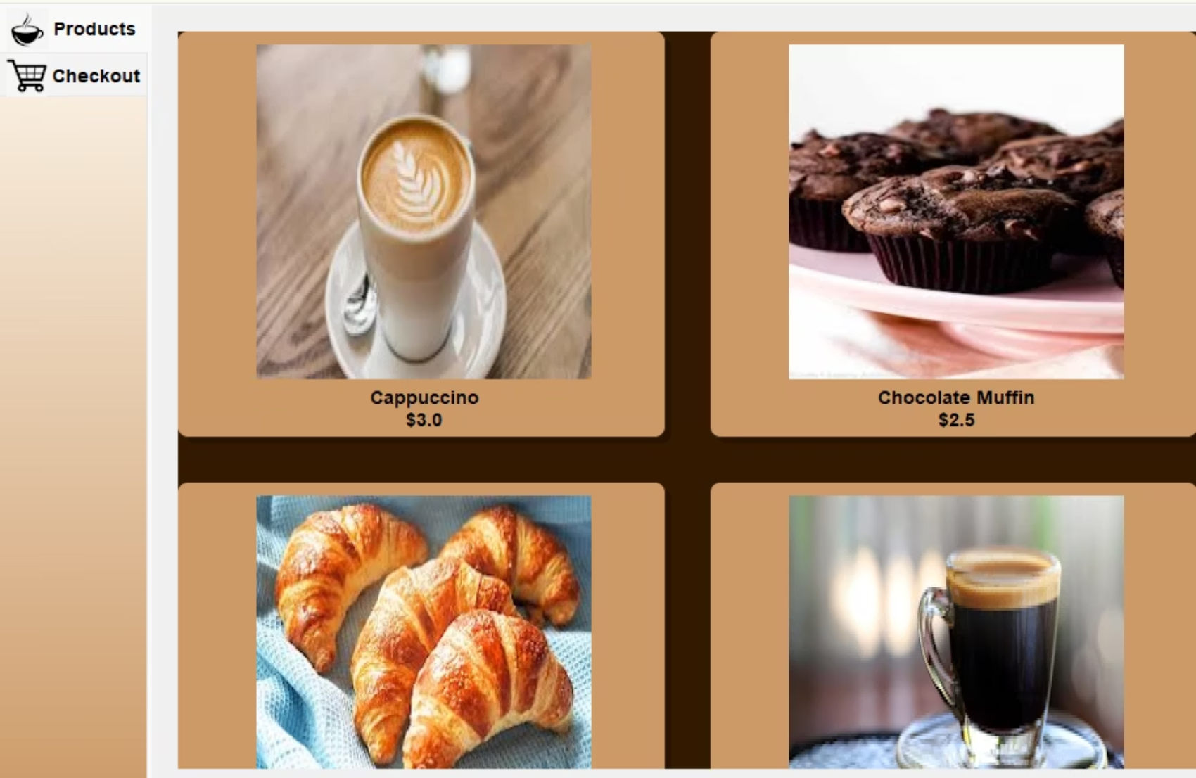
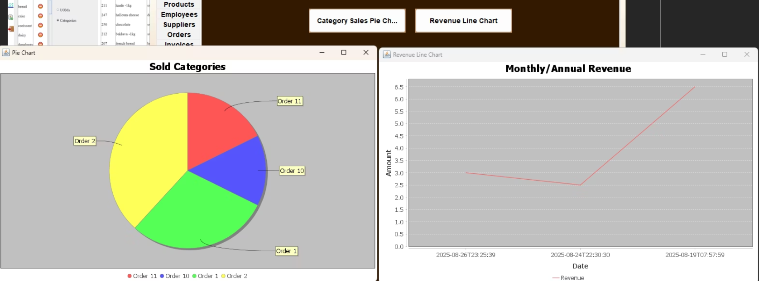
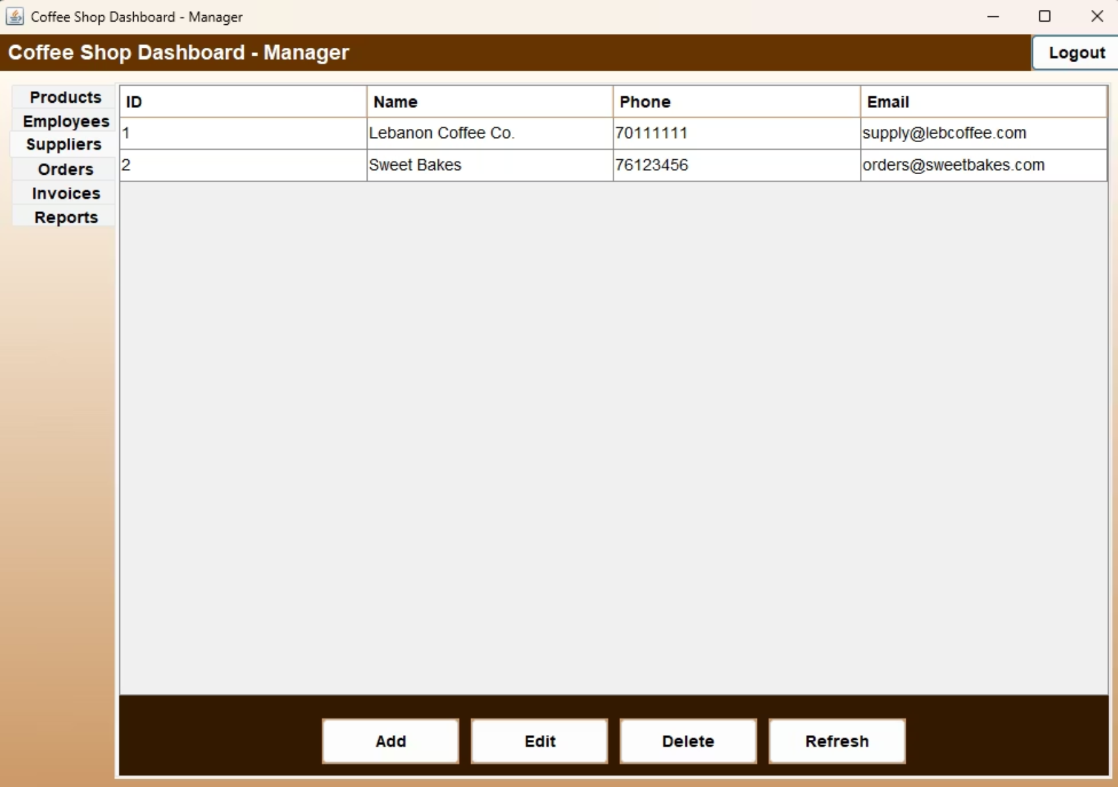
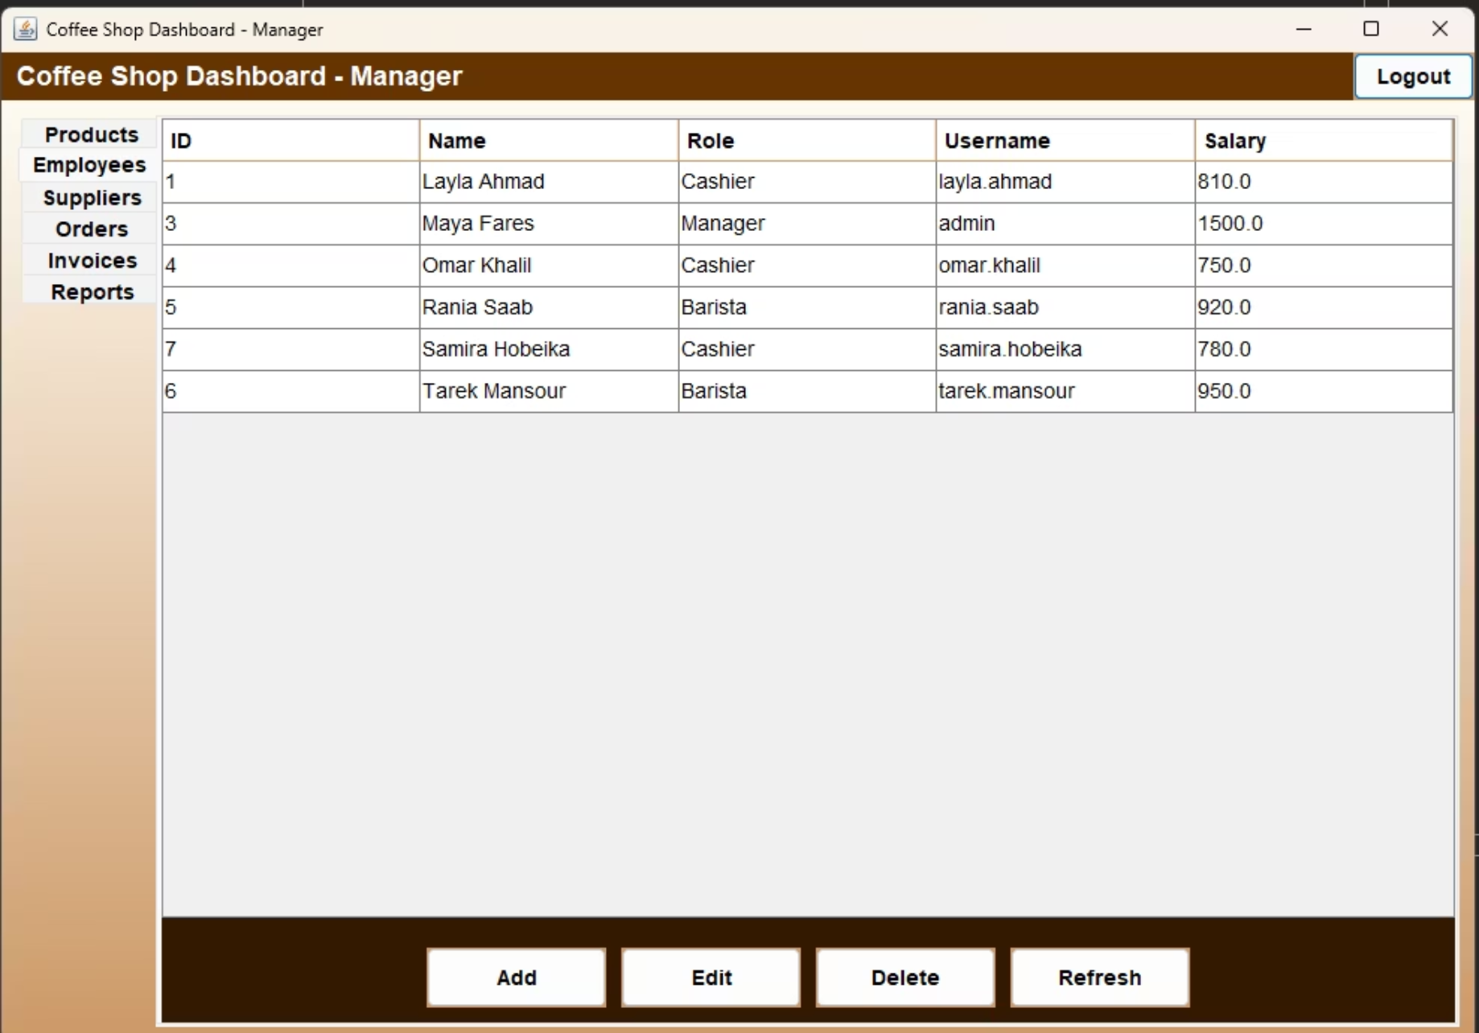
Phase 4 Continued
Software Implementation: Key Features
Beyond core POS, our system includes advanced functionalities designed to enhance operations and customer satisfaction.

Slide 13





Conclusion
Brewing Success: A Holistic System
Through meticulous planning and execution across all phases, we have developed a comprehensive and innovative coffee shop management system designed for efficiency, scalability, and an enhanced user experience.
Seamless User Experience
Robust Data Foundation
Intuitive interfaces for both staff and customers, simplifying daily operations and ordering processes.
A well-structured and secure database ensuring data integrity and reliable reporting for informed decisions.
Scalable & Future-Ready
Integrated Operations
Built to grow with the business, supporting increasing transaction volumes and adaptable for new features.
Connecting POS, inventory, and employee management for a unified, efficient workflow.
This system is poised to revolutionize coffee shop operations, offering a competitive edge in a dynamic market.

Slide 14

Thank You!
We appreciate your time and interest in our innovative coffee shop system. We're excited to brew success together!
Questions?
Please feel free to reach out to us for more information or to schedule a detailed demonstration.

